Slide 1
Digital Portfolio
STUDENT NAME: P. Swetha
REGISTER NO AND NMID: 212401037 asunm161unm161212401037
DEPARTMENT: || BCA “B”
COLLEGE:Prince shri venkateshwara arts and science college
Madras University

Slide 2
PROJECT TITLE
Digital portfolio

Slide 3


AGENDA
Problem Statement
Project Overview
End Users
Tools and Technologies
Portfolio design and Layout
Features and Functionality
Results and Screenshots
Conclusion
Github Link
3/21/2024 Annual Review

Slide 4

PROBLEM STATEMENT
In today’s competitive job market, resumes alone are not enough to create a strong impression. Many candidates struggle to present their skills and education in an attractive and easily accessible format. There is a need for a personal portfolio webpage that highlights key details like career objectives, education, and technical skills in a well-structured and visually appealing way

Slide 5

PROJECT OVERVIEW
This project is a personal portfolio webpage created using HTML and CSS to showcase academic background, skills, and career objectives. The webpage highlights personal details, an "About Me" section, education, and technical skills in an organized and visually appealing layou

Slide 6

WHO ARE THE END USERS?
This portfolio webpage is mainly designed for recruiters, placement officers, peers, and the candidate to showcase skills, education, and career objectives.

Slide 7
TOOLS AND TECHNIQUES
HTML – For structuring the webpage content.
CSS – For styling and layout design.
OneCompiler (Online IDE) – Used to write, compile, and run the code.

Slide 8
POTFOLIO DESIGN AND LAYOUT
This portfolio webpage is designed with a clean and simple layout. The page contains sections like About Me, Education, and Skills, each organized in separate boxes for clarity. A green background and red headings highlight key details, while proper spacing and alignment ensure readability. The design focuses on minimalism and easy navigation, making it suitable as an online resume.
‹#›

Slide 9
FEATURES AND FUNCTIONALITY
About Me Section – Displays a short career objective and personal details.
Education Section – Presents academic background in a structured format.
Skills Section – Highlights technical skills like Python, Java, C++, HTML, CSS, etc.
Simple Layout & Styling – Uses CSS for background colors, headings, and alignment.
Easy to Access – Serves as a quick online resume for recruiters and placement officers.

Slide 10
Github link
https://github.com/swethap9c-lab/TNSDC-FWD-DP.git

Slide 11
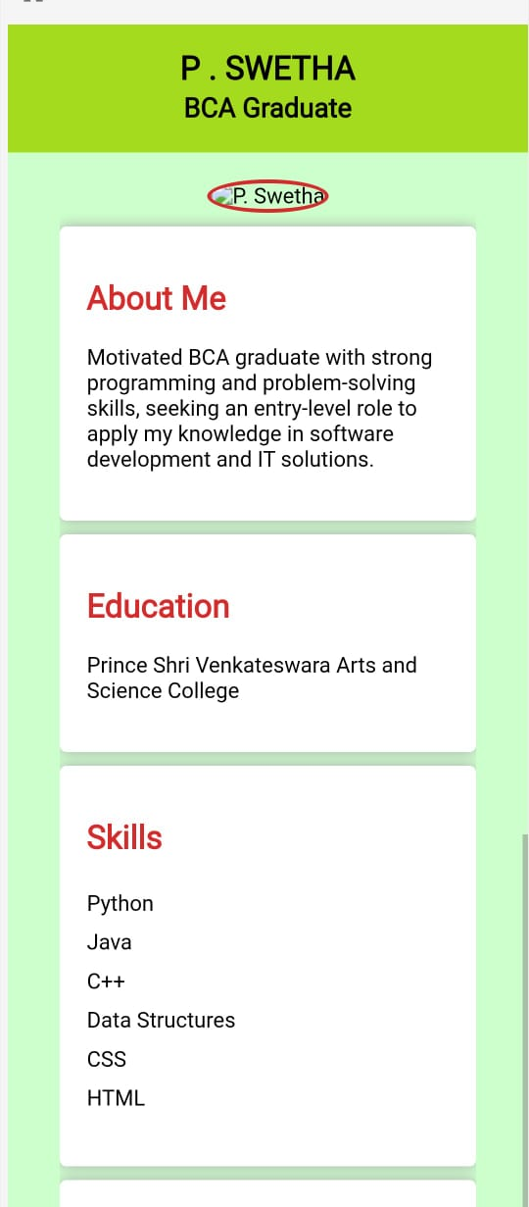

RESULTS AND SCREENSHOTS
3/21/2024 Annual Review
‹#›

Slide 12
CONCLUSION
This portfolio webpage effectively showcases personal details, education, and skills using simple HTML and CSS. It provides a clean and organized design that can be used as an online resume for recruiters and placement purposes. The project demonstrates basic web development knowledge and serves as a foundation for creating more advanced personal websites in the future.
‹#›

